Slide 1
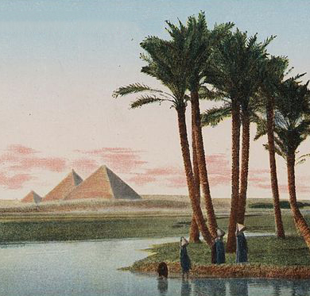
Landscaping & Site Design
(DES411) - Tuesday
Presented By: Farah Walid 2017/04248
Mariam Ashraf 2017/01067
Reem Mahmoud 2017/00183
Maryam Mohamed 2017/08116
Yasmina Ayman 2017/04838
Presented To: Dr. Khaled Asfour
Arch. Radwa Elfardy
Arch. Clara Younan
29 Dec, 2020

Slide 2
Readings
Children in areas of poverty and violence feels sidelined, they lose simple joy of having fun in their childhood, they need a safe place to play and explore, they have the right to play and have fun, sports reduce stress , depression , crime and smoking which is common between kids and teenagers in these areas they need to discover and explore not only by eyes and ears but also by hands, feet and mouths.
Physical activity and stimulation are a must to these kids they need to climb, run, hob and jump. They need to have better social quality of life health and economic values, hypothetically considered an open space holding various activities helping people to relief from daily life circumstances.
Thinking about the main objective for parks is to provide places for people to experience nature, engage in physical activity, and relax. So, their aim was elevated from making a simple regular park to a park which is going to give a full experience of the adventure of being in a well-constructed park. So we decided to make a park which is going to offer; places for individuals to walk, jog, exercise, play, relax, or even meditate and the park may have specific facilities for sports, exercise, and other vigorous activities. Taking into consideration the mistakes that were made in the Egyptian parks like; Al Azhar Park, Al Orman Park, Al Andulas Park, or El Horreya garden. As the lack of sitting areas, low maintenance, safety of the park, the view of the park, or the activities that are going to make the park special and unique.
The five senses (sight, smell, hearing, taste and touch) are the different ways that our human bodies receive information; helping us to understand our surroundings and our environment. For small people, these are just being understood and recognised. They can take quite a bit of thinking about to work out which senses are in play at which point. It is important to try and make children aware of the different senses as early as possible to help them join up their thoughts and experiences, and understand how their bodies work
References:
Towards Social Quality of life Through Cairene Public Parks - Unicef Sport Recreation - Contribution of Public Parks to Physical Activity -https://www.twinkl.com/blog/the-five-senses-activity

Slide 3
Problem Problems:
Today, children face problems regarding a place to play freely and safely instead of the streets. Gathering and playing in the streets causes the kids to face violence and even sexual harassment from strangers. Not only most children cannot play safely in a protected place, but also some children have jobs after school that they also can’t find places to gain more knowledge and more experience to help them in their jobs as it leads them to take responsibility early in their life; which shows that they need a specific place where they can feel their childhood and clear their minds a little bit and at the same time to gain more experience . On the other hand, Tourists travel to Egypt to visit historic places and monuments but in other case their children which some of them think history is boring and can end up winning and bothering their parents from knowing the Egyptian history with amusement.
Vision:
Our vision is to create a space that will be safe for our kids to live their childhood safely and enlighten their minds, as well as the tourists and their kids will be able to explore different type of childhood they didn’t experience in their hometowns.
Keyword:
Enlightenment
Statistics:
Percentage of children in nazlet al seman from 0-18 years old 47%
10% read and write without certificate
Percentage 57% of children that drop from school to work and financial problems
Percentage of dropping schools in nazlet al Seman 26%
Jobs found in nazlet seman rugs, pottery, bazar, tour guides, hourse ridings, and helps in digging with archeologists.
Most common languages from three to four languages french, italian, Russian, and English
Reference: مركز التعبئة و الاحصاء

Slide 4
Stories:
1- Puppet show: the puppet show is located near the community entrance to welcome the children and attract them to enter the site where the puppet show is distributed into six parts to surround the entrance to fill the children with information and entertainment by dividing it to three puppet theaters on the right and three puppet theaters on the left to deliver the experience and information about job skills that kids will receive to help them in the future. Why puppet show is used to transfer some experience? Is a way where kids will be attracted to dolls that acts out to give them information to let them sit and concentrate with the information or experience that will be delivered to them.
2- Football field: football field is added to the space to higher the physical skills where it follows the quote that says the perfect mind in healthy body. Where at the same time it is the dream of every child in our site to learn football and to become professional as a lot of famous football players.
3- Playground: playground is added because every child has the right to play and have fun. To increase as well as their physical movements. To enhance their five sense by using musical games to hear and detect the sounds, by placing hiking, mini basket ball field, sand box to enhance the touching where kids use to sense different objects. And the smell will be heighten by the surrounding from the grouping that is added in the zone from trees to shrub where they can mark the place with.
4- Theater: theater is the zone where it will teach or will improve the children’s language skills the common foreign languages that surrounds the site and mostly used. How the languages will be received and taught to the kids? by using the screen to paly documentaries on it to teach them and by using the stage to host some bands that will perform songs with different languages where it helps to memorize and learn faster as it is the most common ways used nowadays to learn languages faster and better.
5- Crafts: is the space that is divided into three zones from painting zone to improve the sense of art skills that will give them the chance to create and improve their artistic skills while designing in the second zone (sculpture) and third zone (pottery) where these two activities main aim to help them in creating the figures that are mostly used in bazars to sell around the site for tourists and Egyptians as well.

Slide 5
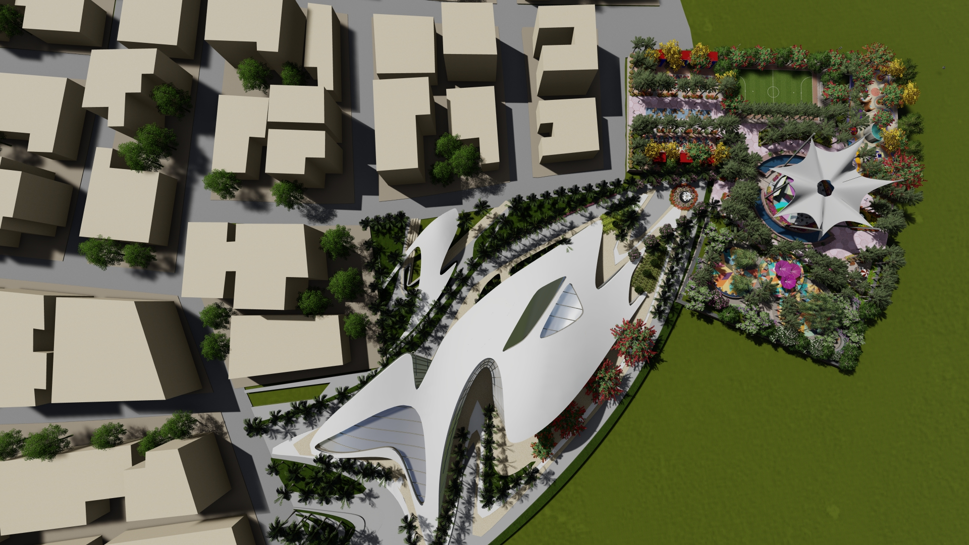
Layout with the surrounding context

Slide 6
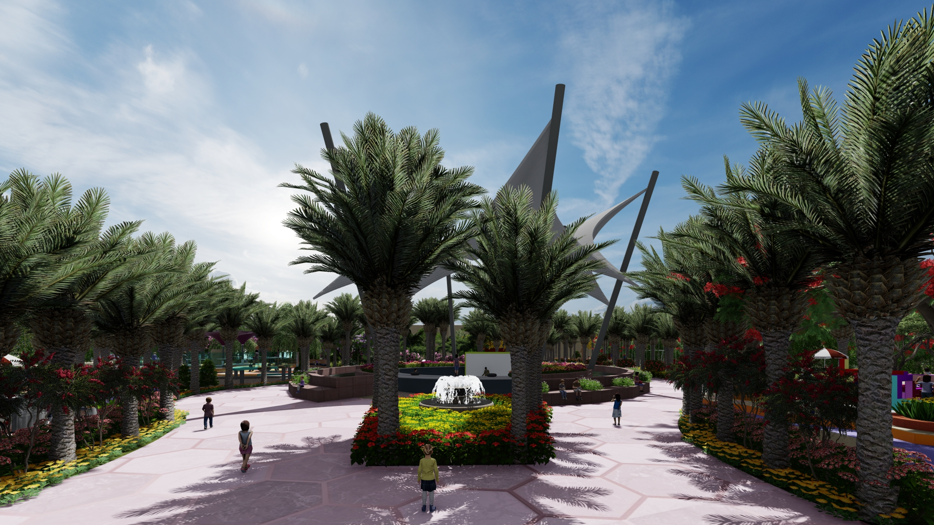
Entrance

Slide 7
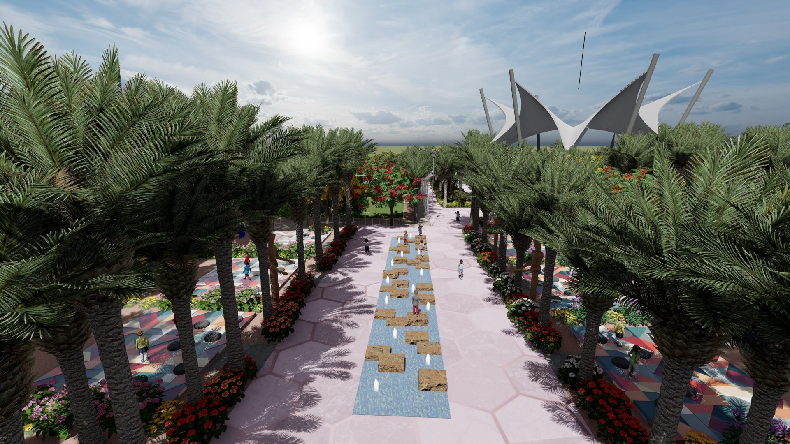
Entrance

Slide 8
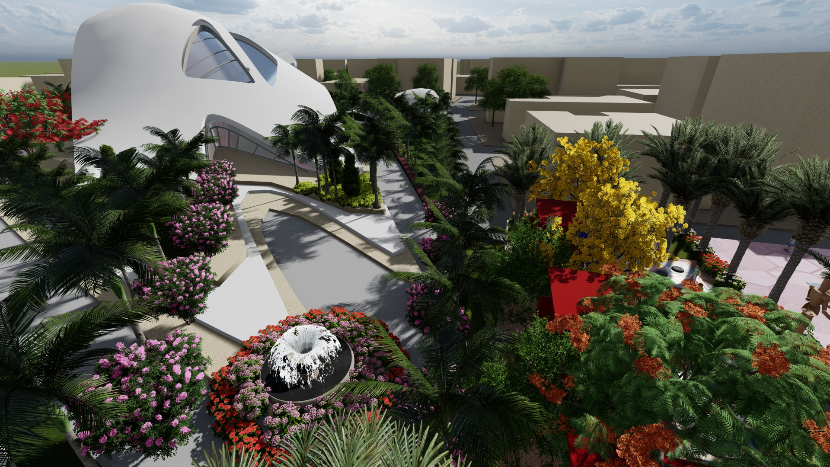
Entrance

Slide 9
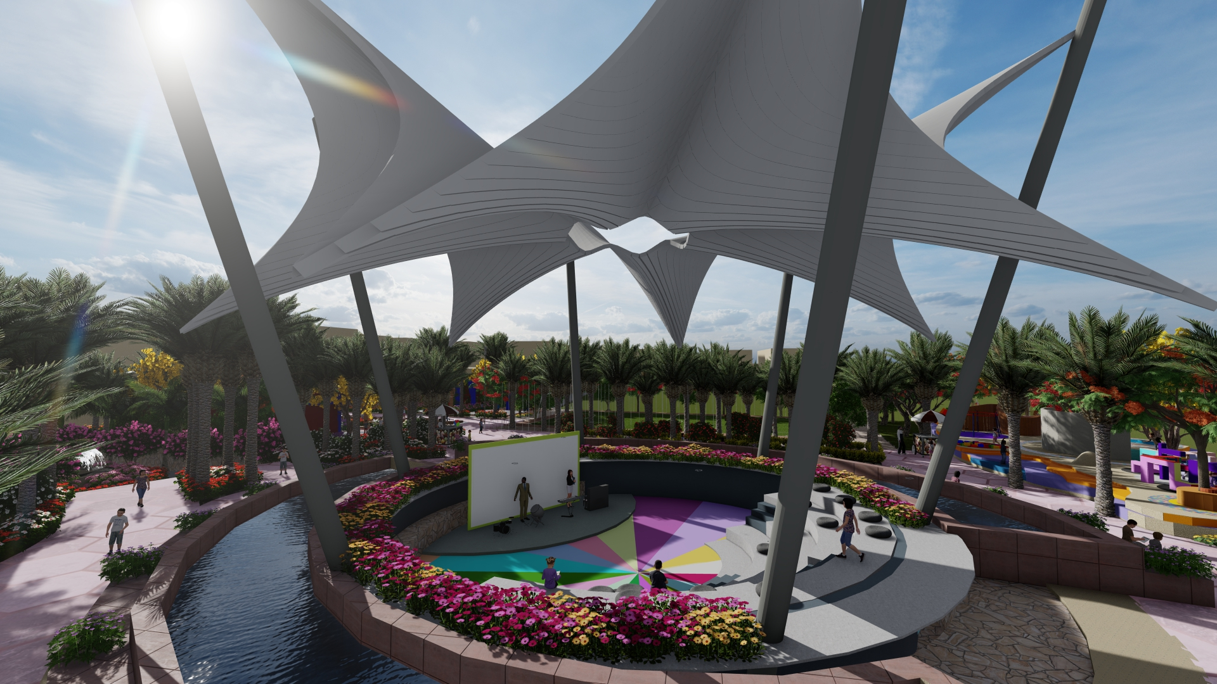
Cinema and theatre
Documentaries and musical performances for the kids to learn languages

Slide 10
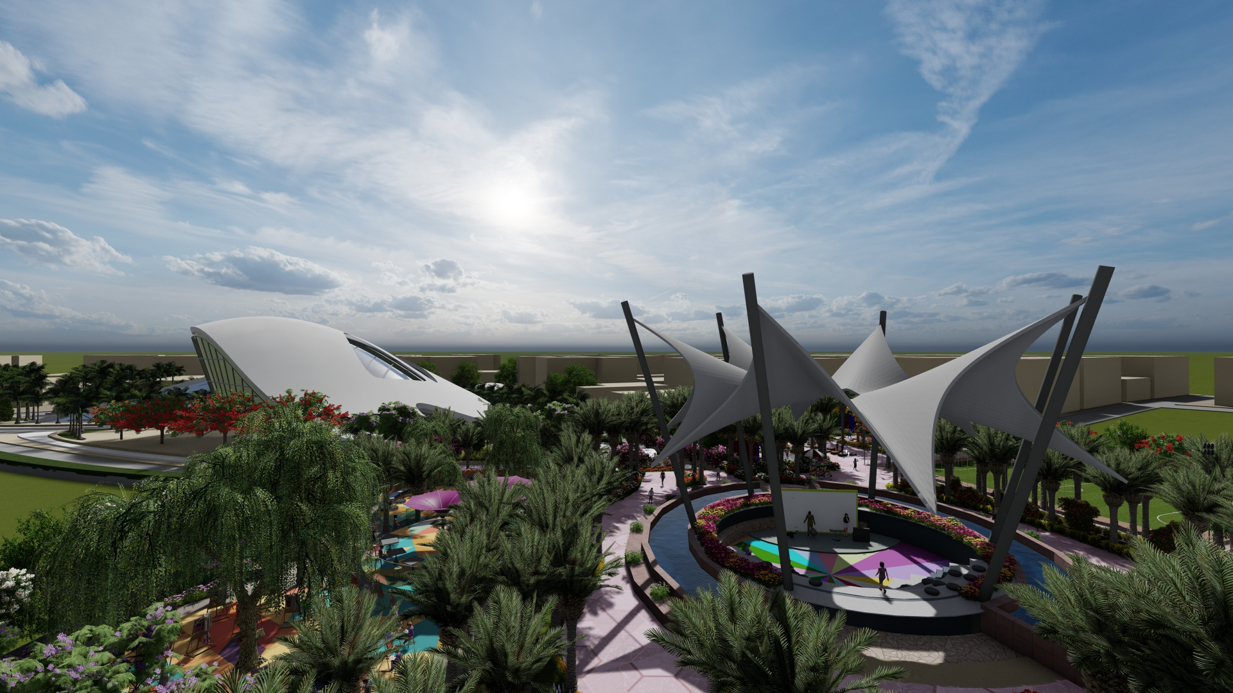
Cinema and theatre
Documentaries and musical performances for the kids to learn languages

Slide 11
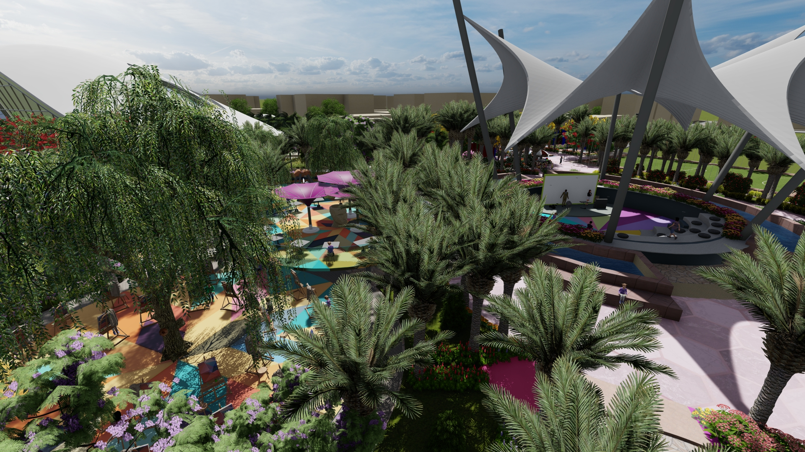
Cinema and theatre
Documentaries and musical performances for the kids to learn languages

Slide 12
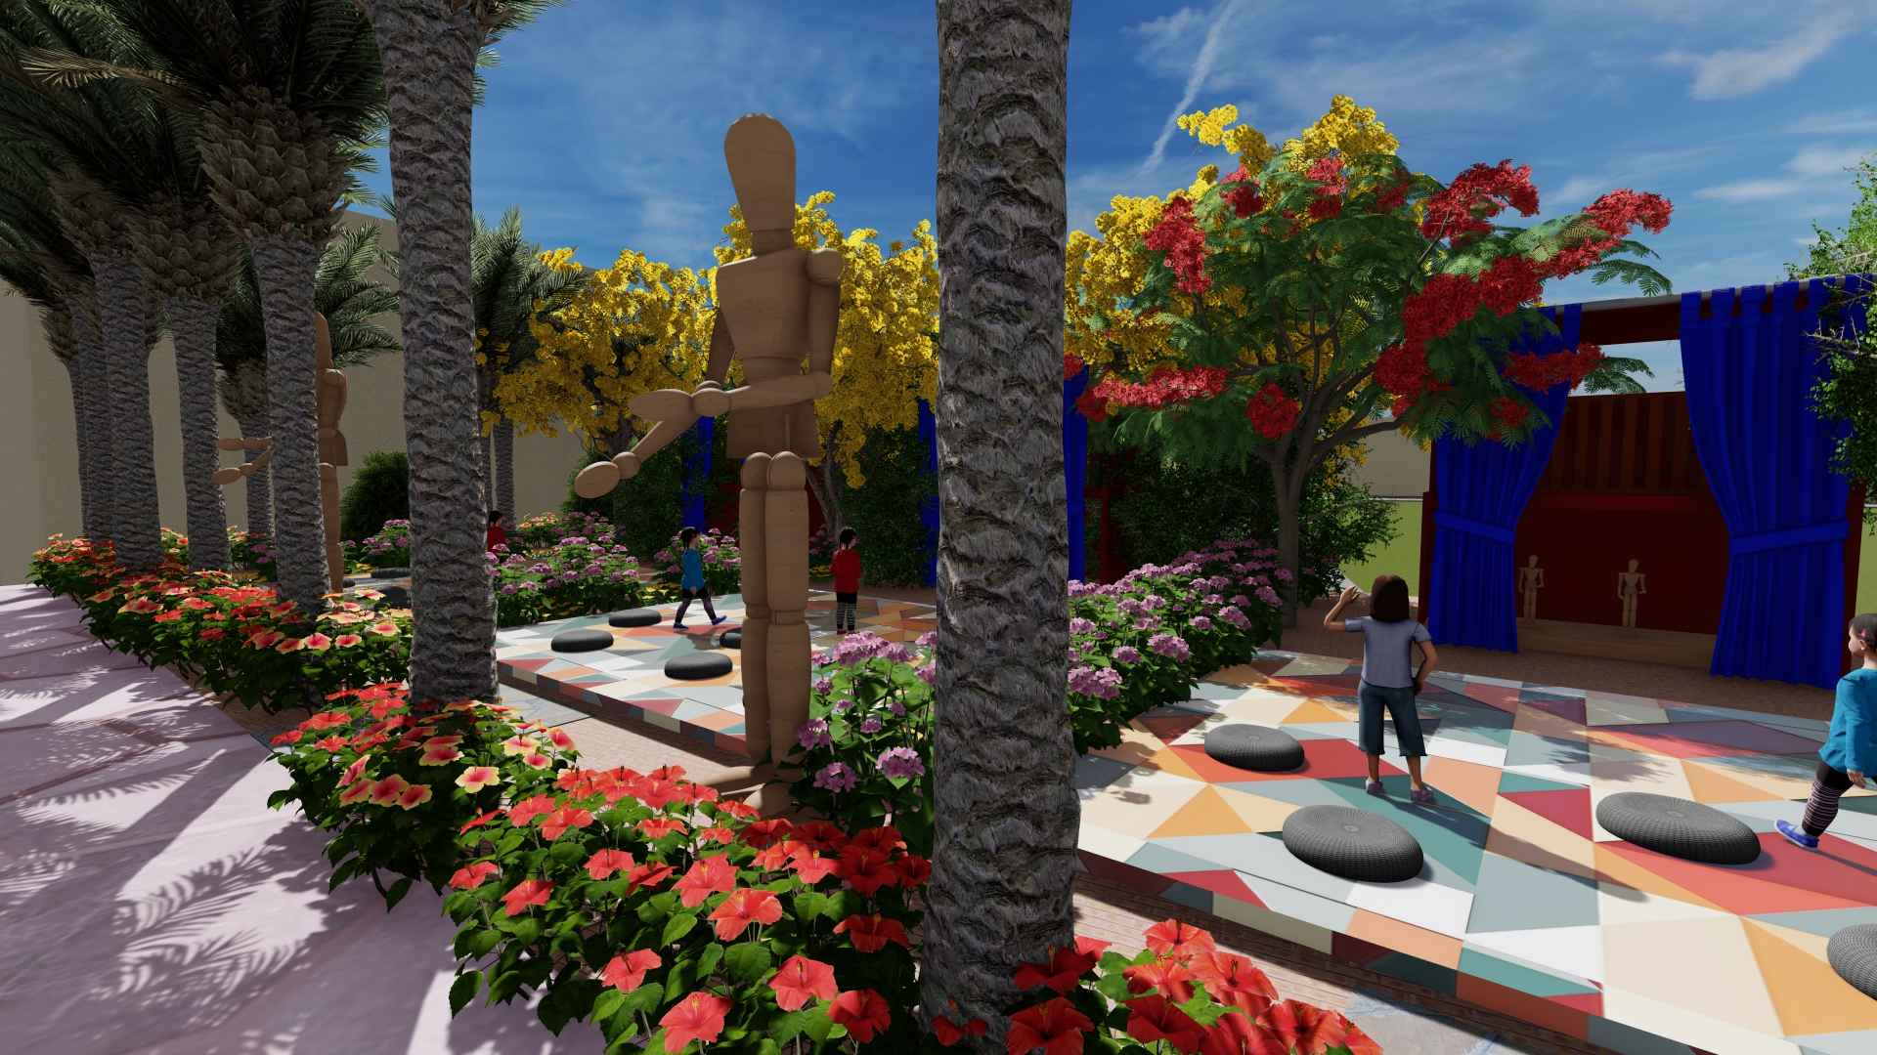
Puppet shows
Attracts the kids to come and gain experience about different culture and enlighten them about their future

Slide 13
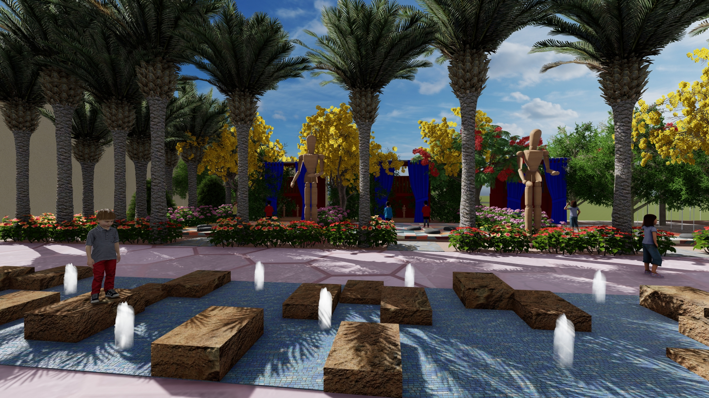
Puppet shows
Attracts the kids to come and gain experience about different culture and enlighten them about their future

Slide 14
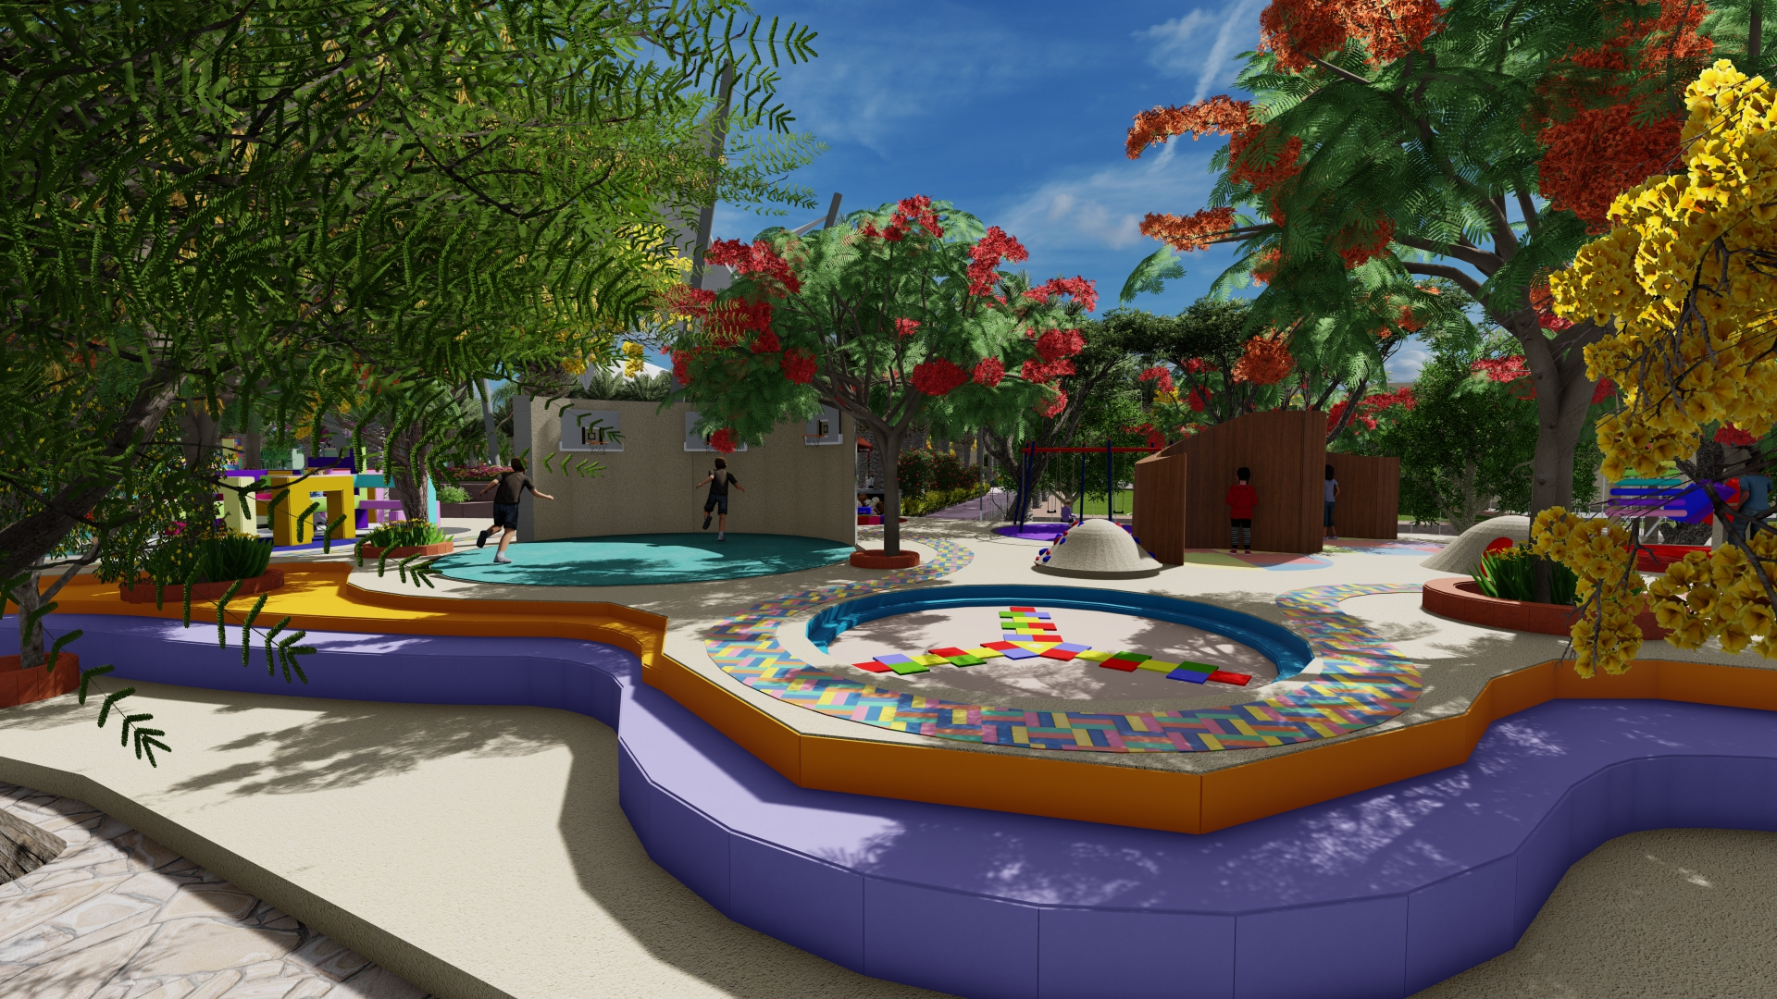
Playground
To enhance their physical interaction

Slide 15
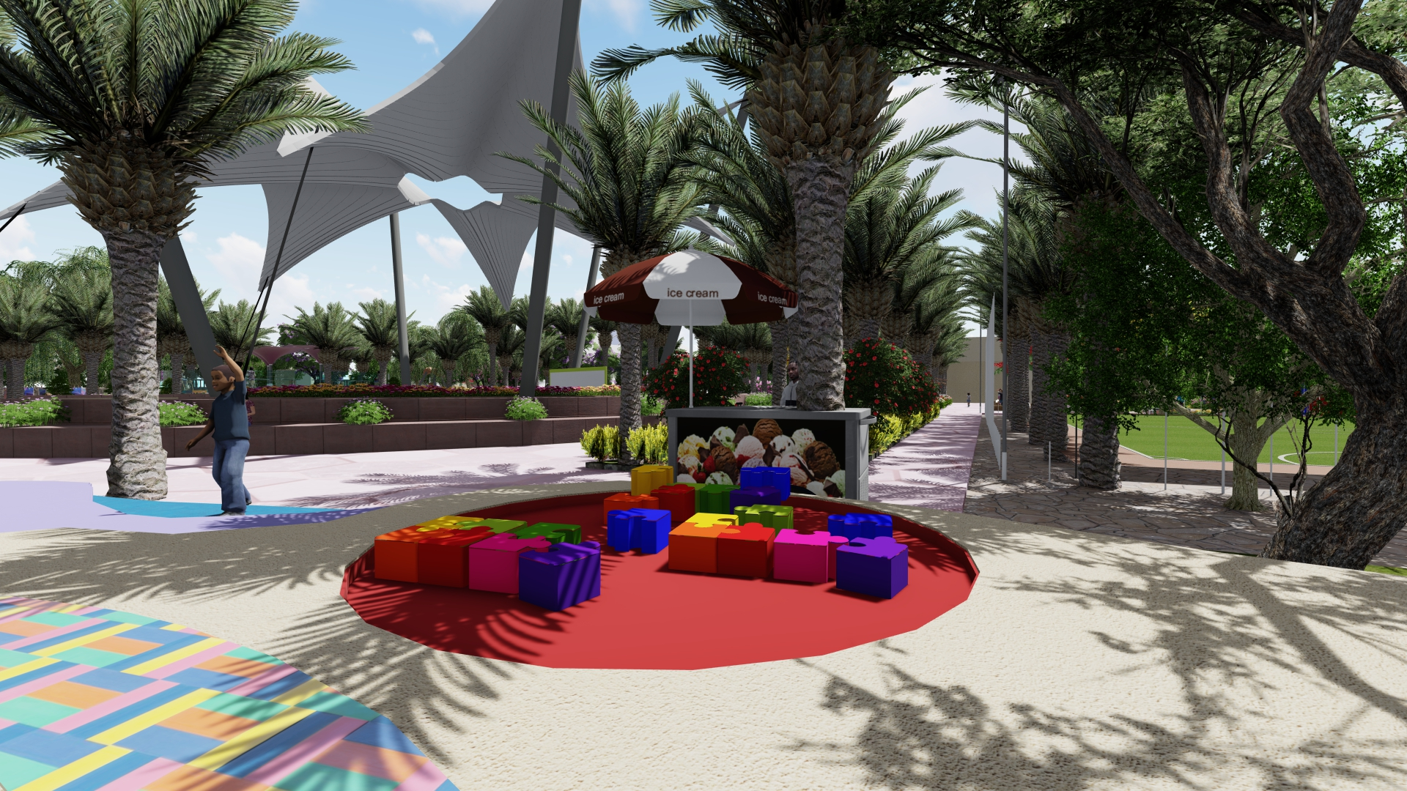
Playground
To enhance their physical interaction

Slide 16
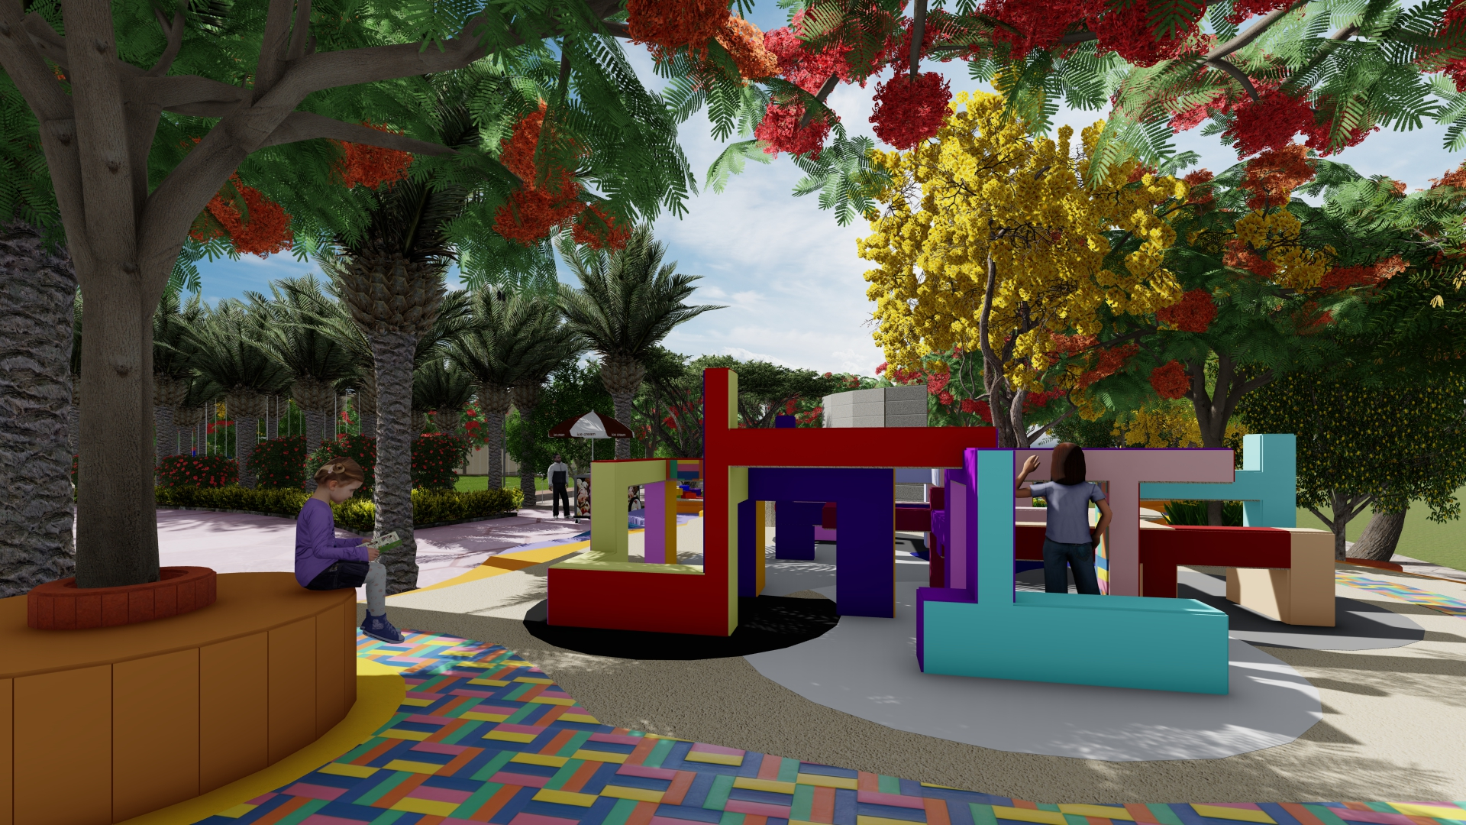
Playground
To enhance their physical interaction

Slide 17
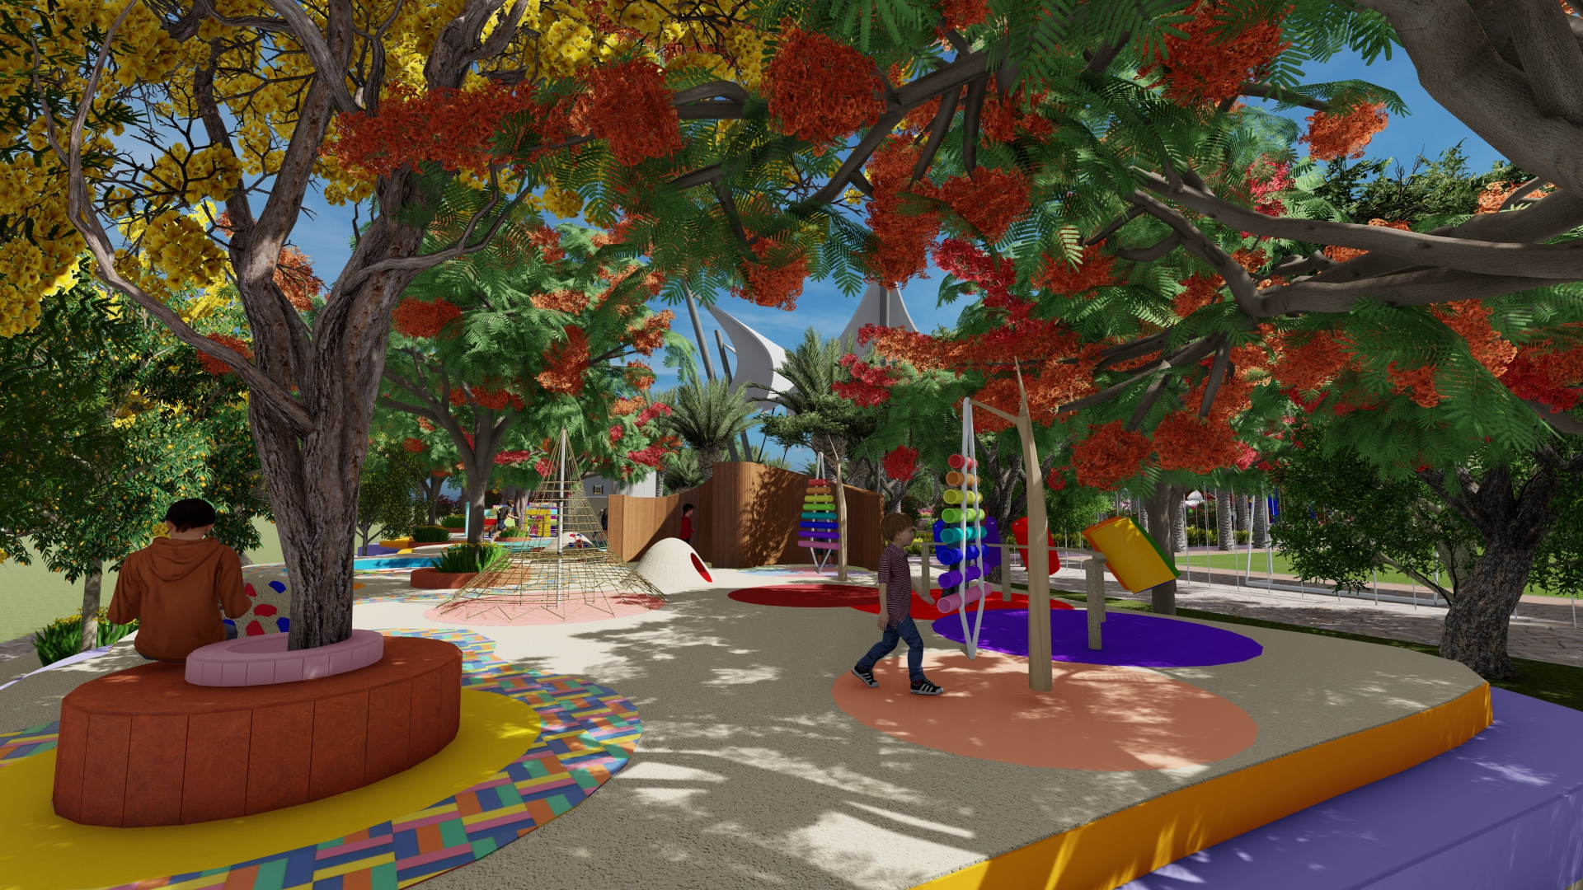
Playground
To enhance their physical interaction

Slide 18
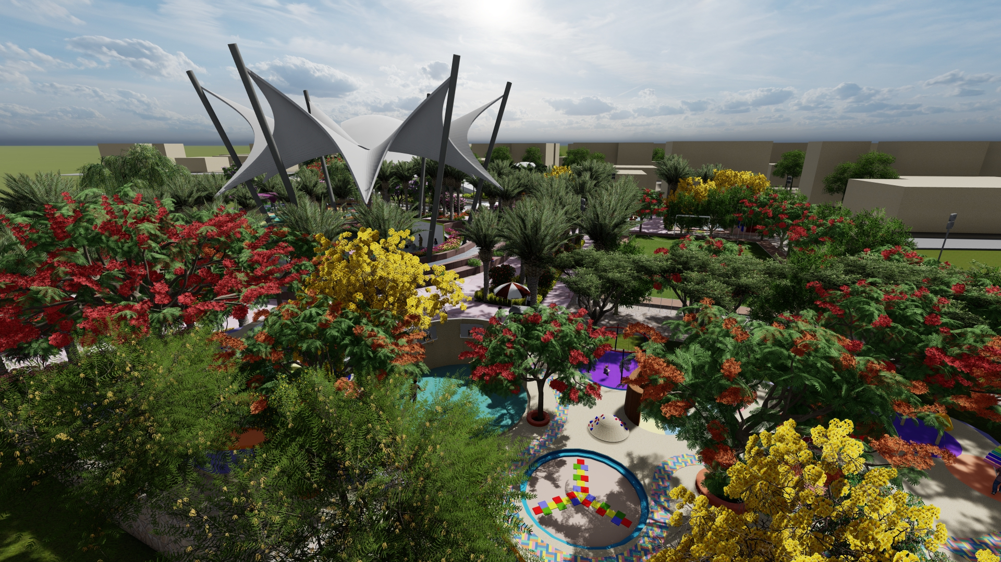
Playground
To enhance their physical interaction

Slide 19
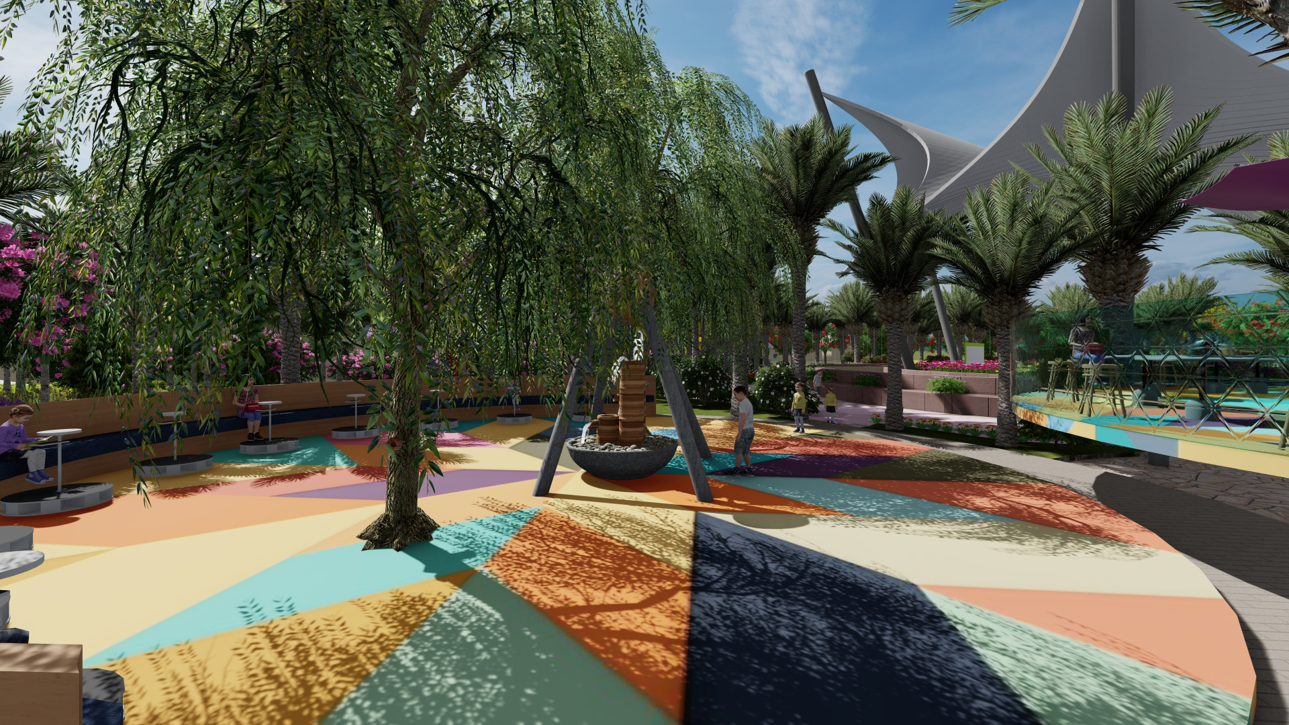
Pottery
to increase their crafting skills

Slide 20
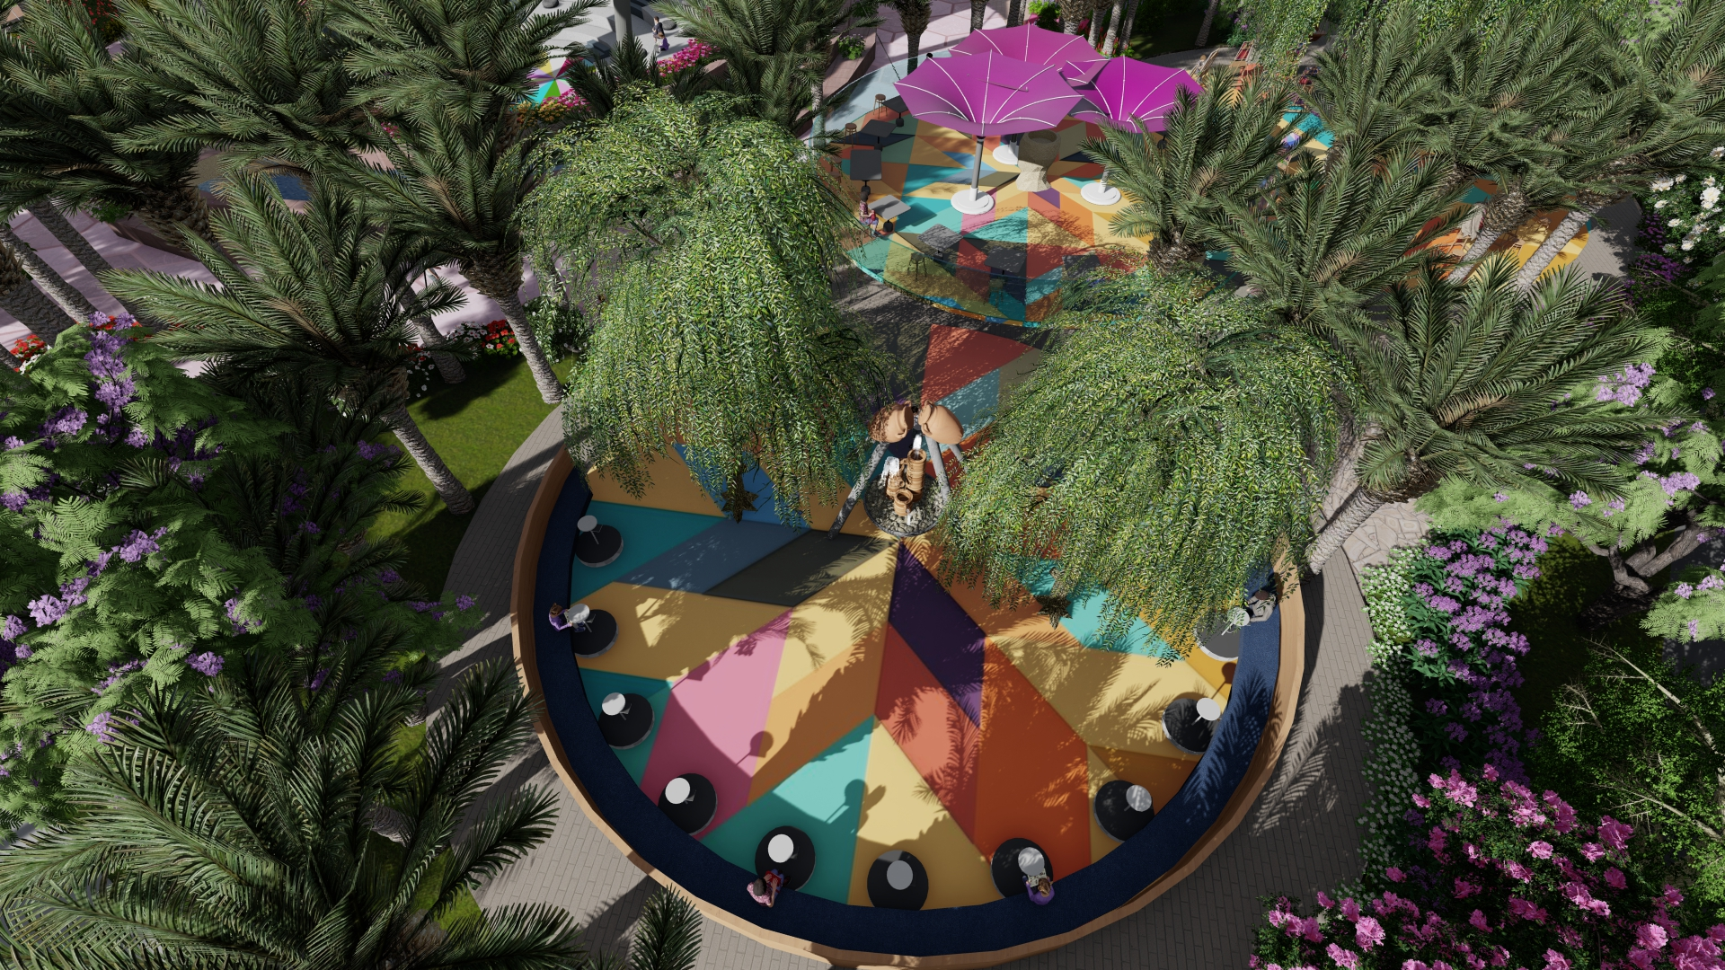
Pottery
to increase their crafting skills

Slide 21
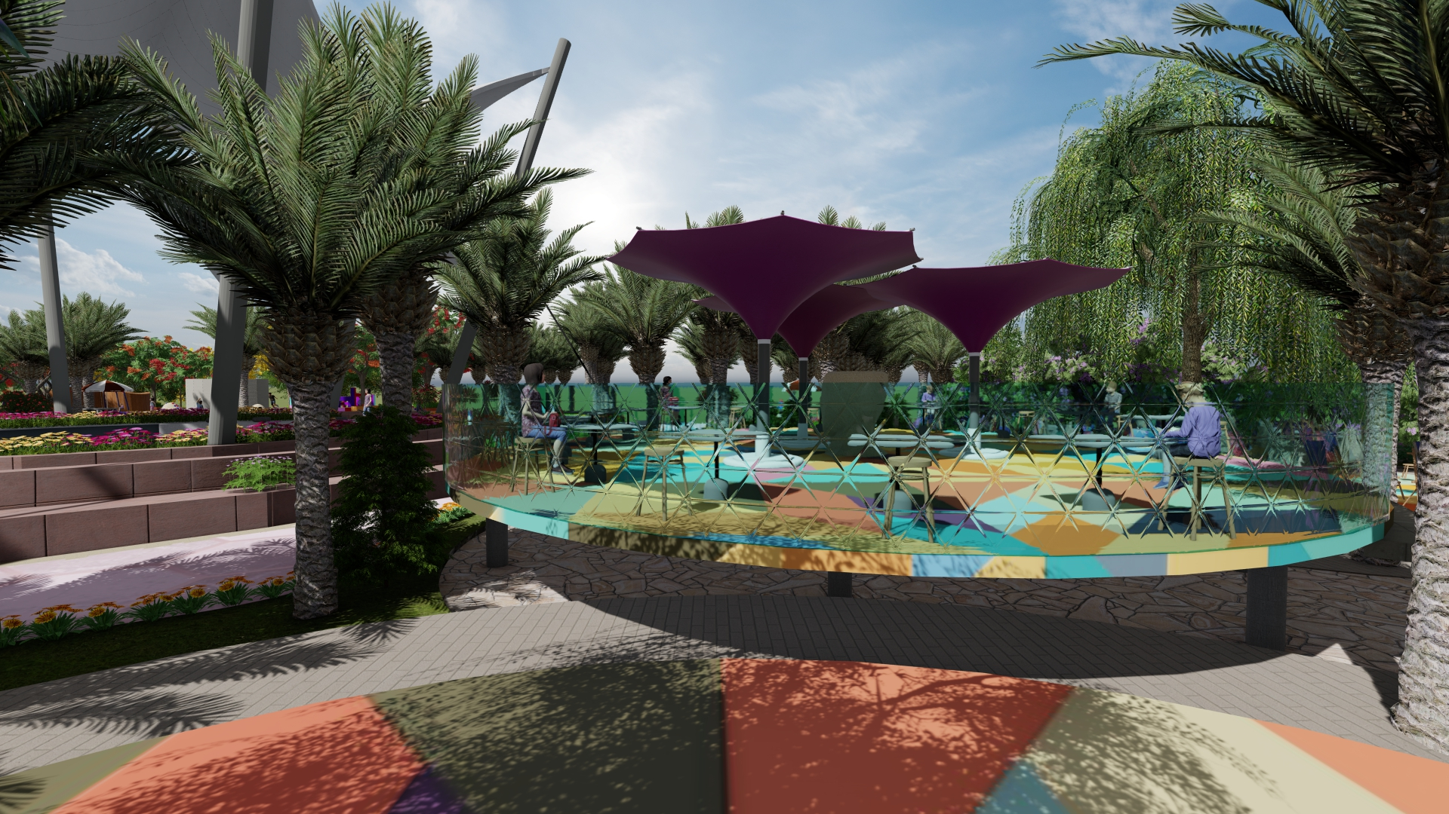
Sculpture
to increase their crafting skills

Slide 22
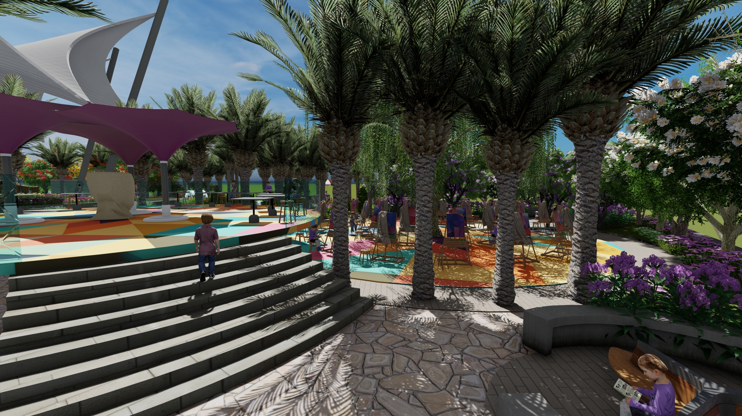
Sculpture
to increase their crafting skills

Slide 23
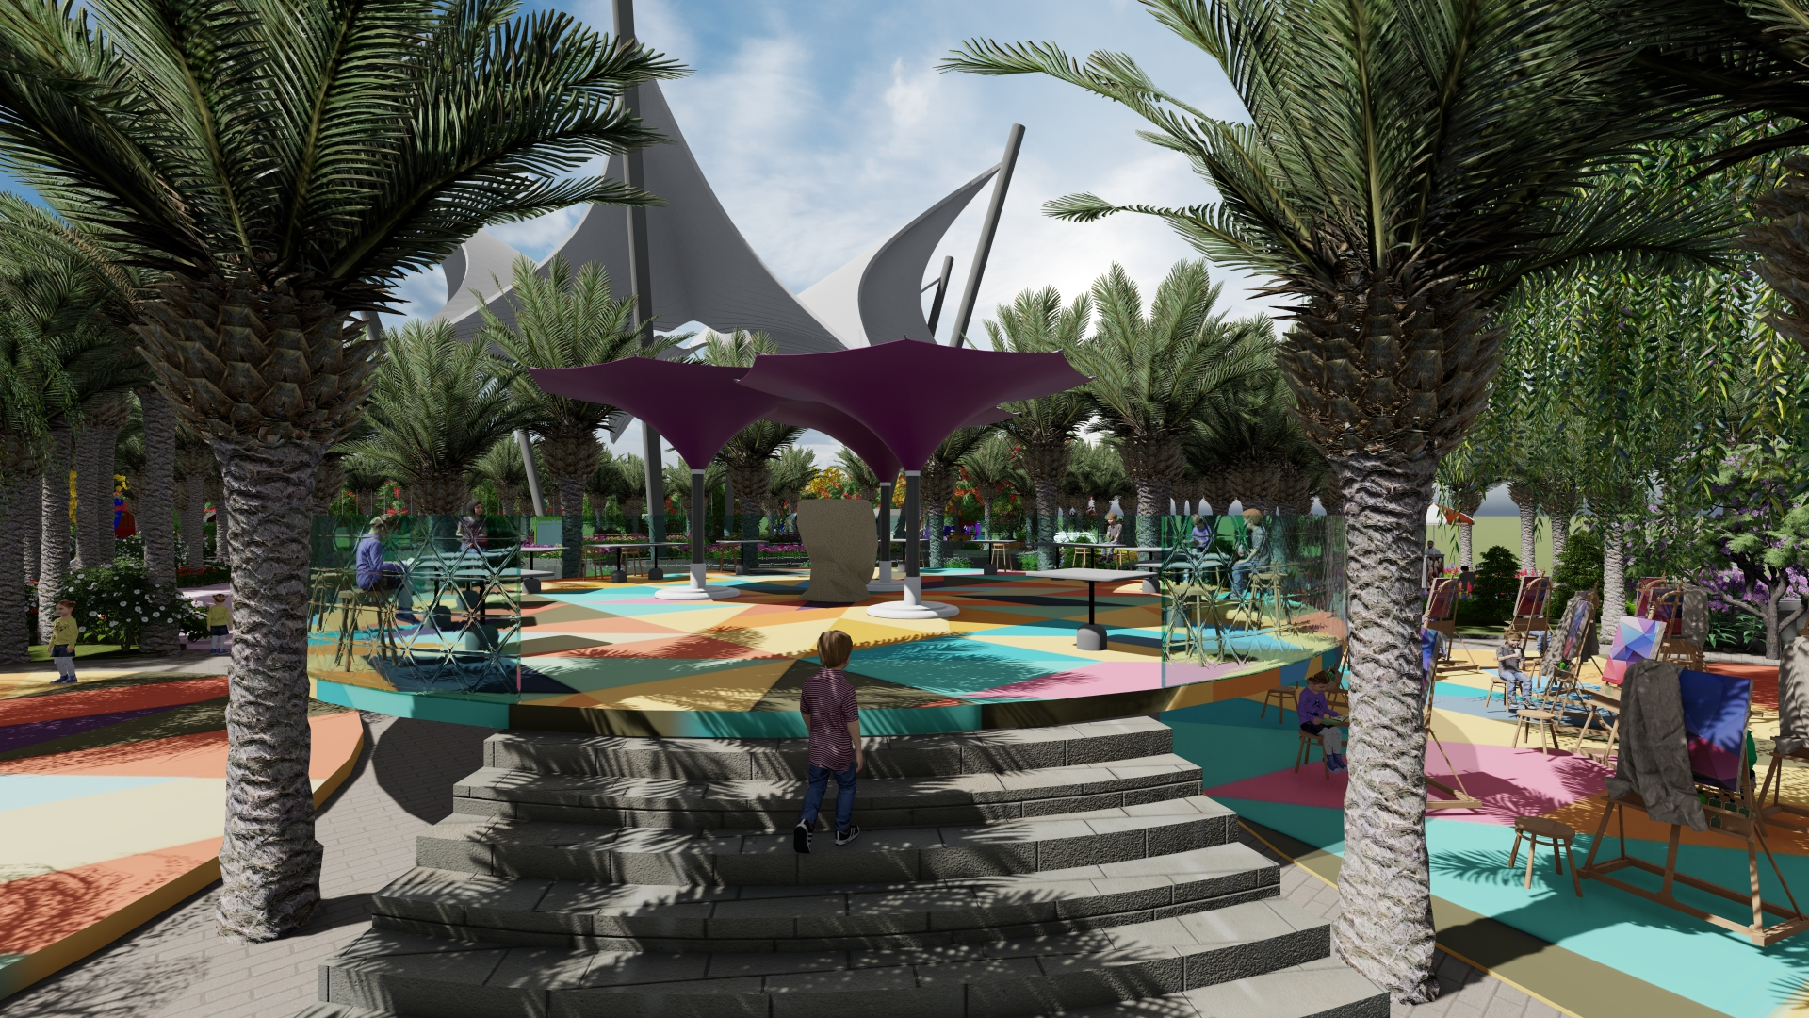
Sculpture
to increase their crafting skills

Slide 24
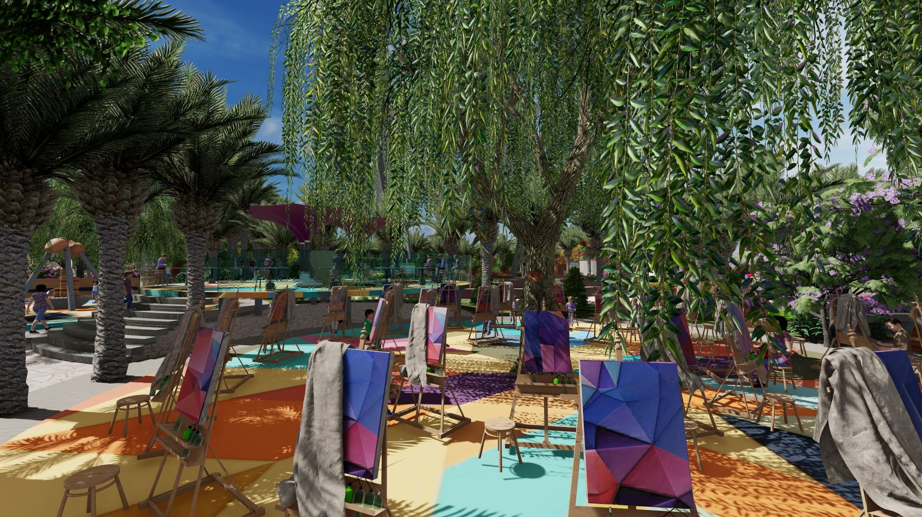
Painting
to increase their artistic taste to create in pottery and sculpting that will be useful in their future jobs

Slide 25
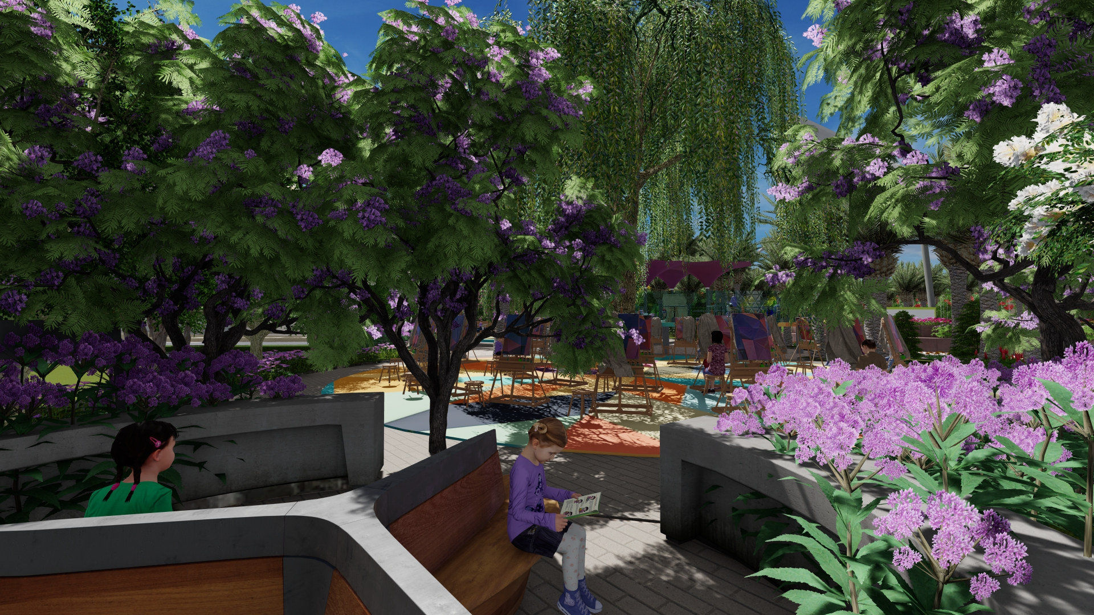
Painting
to increase their artistic taste to create in pottery and sculpting that will be useful in their future jobs

Slide 26
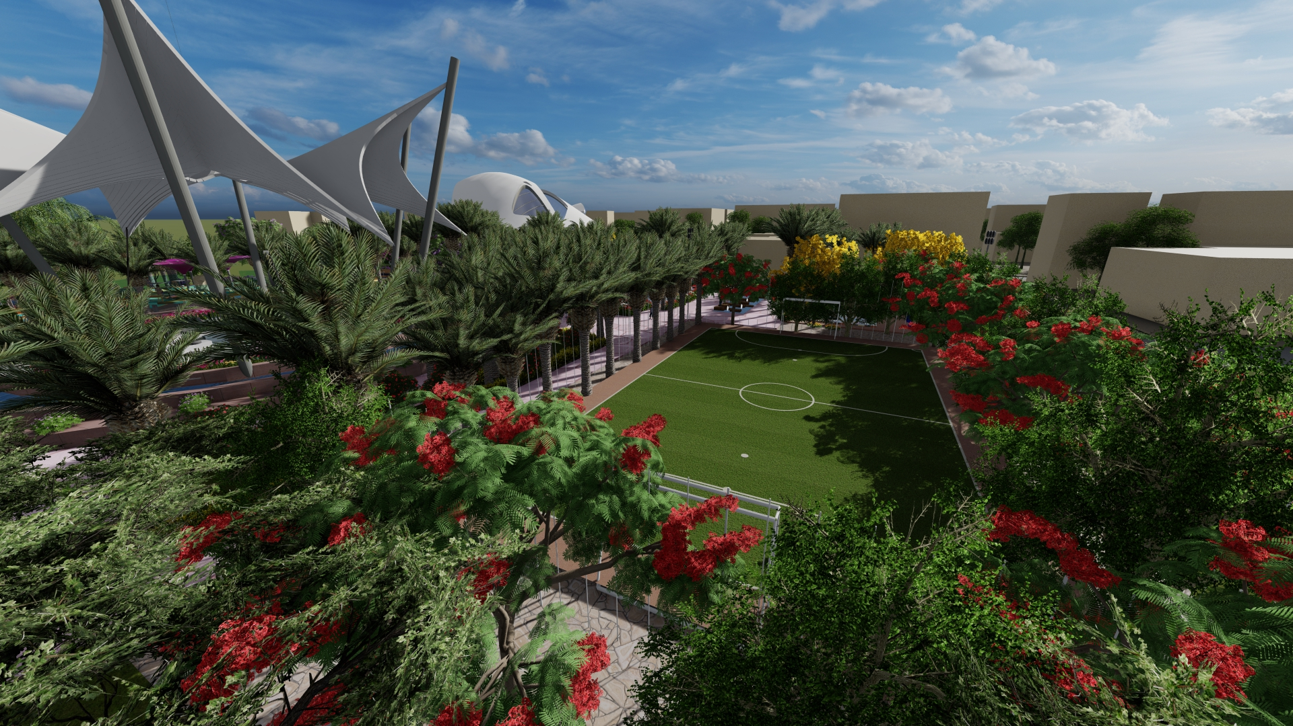
Football field
Working on their fitness as most kids nowadays like football and wants to improve their skills in it.

